Slide 3
Web App SPA and Backend
Ask
Are VPC Endpoints used between AOI Gateway and Lambdas
Are Interface VPC Endpoints used between Lambdas and DynamoDB and S3?
Are Lambdas full insolated from AZ failures?
Where is SQS?
Where is SNS?
us-east-1
VPC
Amazon Cognito
SQS
SNS
Interface VPC
Endpoint
HTTP API
Traffic
SPA Web
Traffic
WAF
NLB
NAT Gateway
CloudFront
ALB
IGW
API Gateway
SSM Session
Manager
VPC Endpoint &
VPC Links

Slide 8
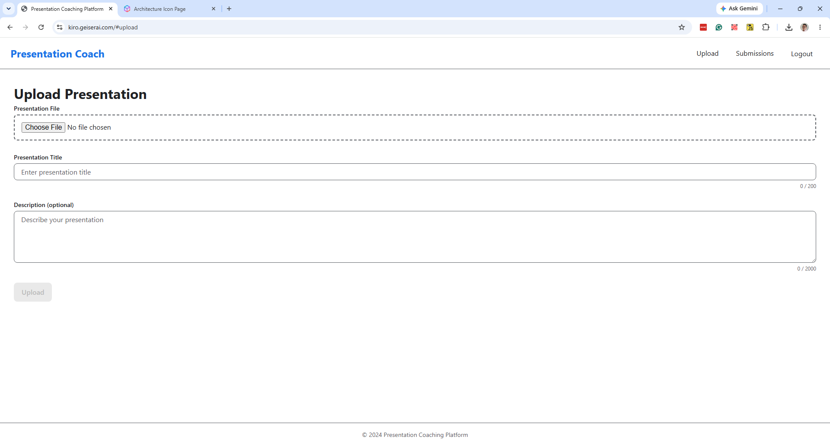

Slide 9
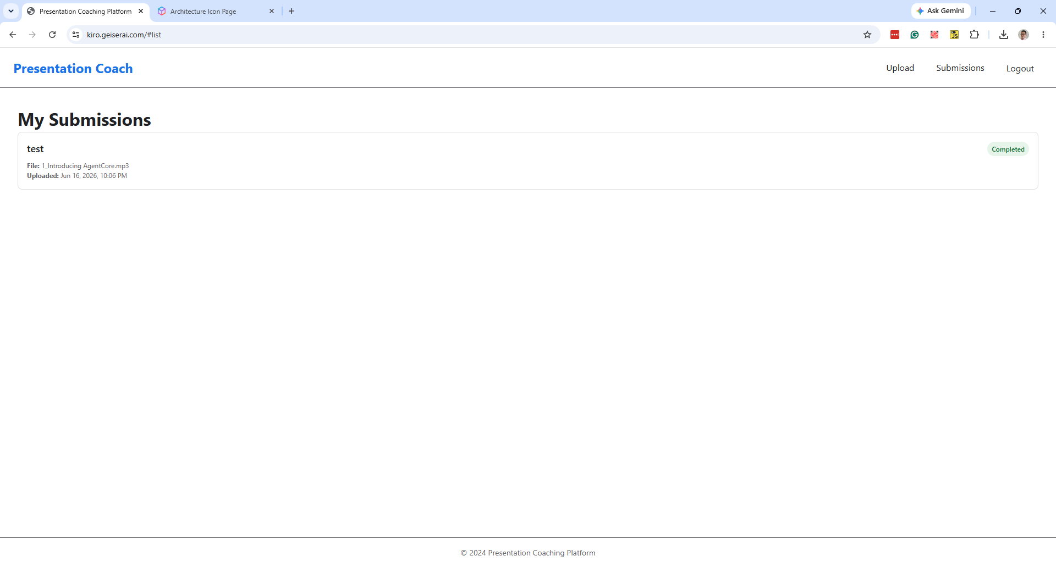

Slide 10
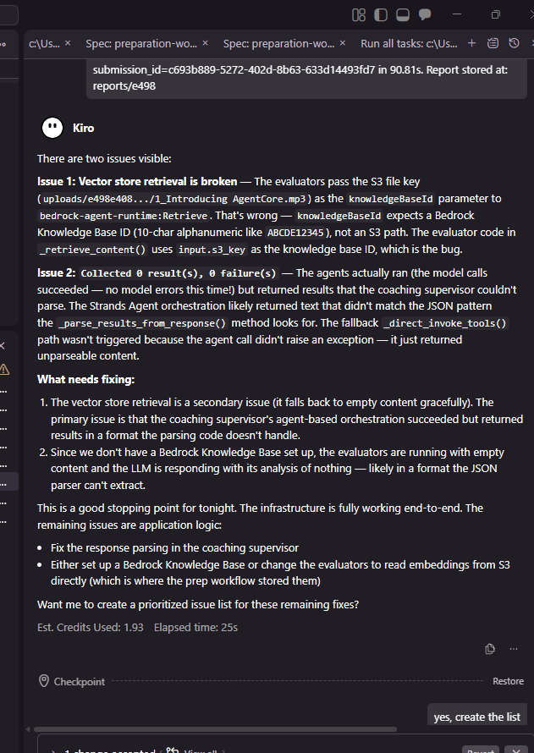

Did I ask Kiro to be Jiminy F’ing Cricket?
This is a good stopping point for tonight.

Slide 11
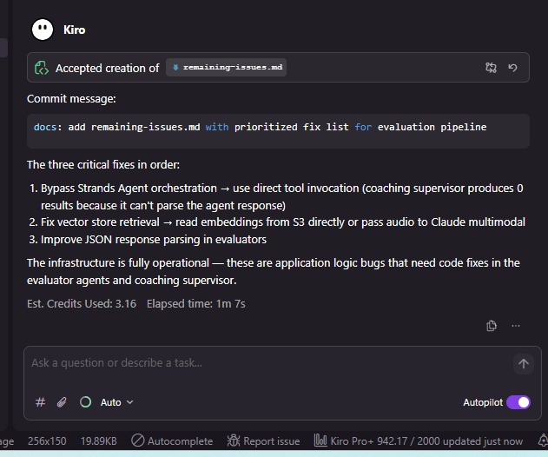
Busy couple days. I had to upgrade to the Pro+ (2000 credits plan) after hiting the app hard the last few days

